Slide 1

CHRISTMAS JEOPARDY

Slide 2
SONG TITLES | THE BIBLE | DATES AND DAYS | FOOD | SANTA CLAUS
€100 | €100 | €100 | €100 | €100
€200 | €200 | €200 | €200 | €200
€300 | €300 | €300 | €300 | €300
€400 | €400 | €400 | €400 | €400

Slide 3
1 – 100
Dashing through the __ __ __ __ On a one horse open sleigh O'er the fields we go, Laughing all the __ __ __ ...
SNOW
WAY

Slide 5
1 – 200
He's making a _ _ _ _ And checking it twice He's gonna find out
who's _ _ _ _ _ _ _ and nice Santa Claus is coming to town
LIST NAUGHTY

Slide 7
1 – 300
I don't want a lot for _ _ _ _ _ _ _ _ _
There's just one thing I need
I don't care about _ _ _ _ _ _ _ _
Underneath the Christmas tree
CHRISTMAS
PRESENTS

Slide 9
1 – 400
_ _ _ _ _ _ night, holy night
All is calm, all is bright Round yon Virgin Mother and Child Holy Infant so tender and mild Sleep in heavenly _ _ _ _ _
SILENT
PEACE

Slide 11
2 – 100
Who was born in Bethlehem on 25th December?
JESUS / JESUS CHRIST

Slide 13
2 – 200
Baby Jesus was born in a
a) hospital b) stable c) forest
STABLE

Slide 15
Jesus’ mother and ´father´ are ...
2 – 300
MARY AND JOSEPH

Slide 17
Melchior, Balthazar and Casper are the three ...
2 – 400
KINGS / WISE MEN

Slide 19
3 – 100
Christmas Day is on ...
25th December

Slide 21
3 – 200
Christmas Eve is on ...
24th December

Slide 23
3 – 300
New Year’s Eve is on ...
31st December

Slide 25
3 – 400
What day of the week is Christmas Day this year?
Friday

Slide 27
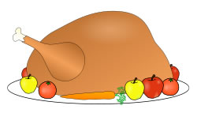
4 - 100
People traditionally eat roast
at Christmas.
TURKEY

Slide 29

4 – 200
A traditional dessert with dried fruit. People in Britain usually eat it at the end of Christmas dinner.
CHRISTMAS PUDDING

Slide 31

4 – 300
People eat a special
biscuit at Christmas time.
They call it ...
GINGERBREAD MAN

Slide 33

4 – 400
A special treat for children
eaten at Christmas time.
CANDY CANE

Slide 35
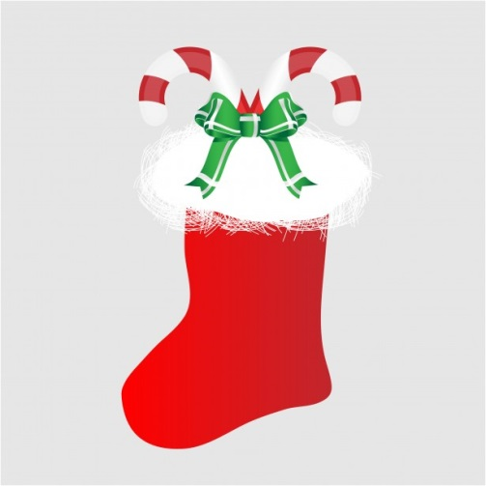
5 – 100
A large red sock that children leave out on Christmas Eve.
STOCKING

Slide 37
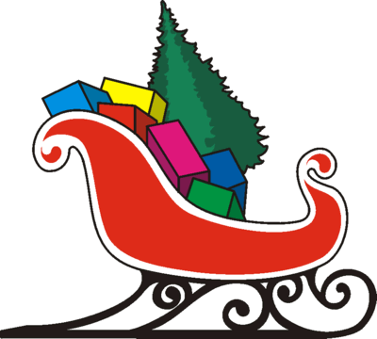
5 – 200
Santa travels in his ...
SLEIGH

Slide 39
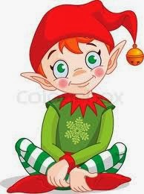
5 – 300
Little people who help
Santa make presents for
children are called...
ELVES

Slide 41
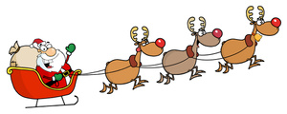
5 – 400
Rudolph is Santa’s reindeer.
Name two more reindeer that
pull Santa’s sleigh.
DASHER, DANCER, PRANCER, VIXEN, COMET, CUPID, DONNER, BLITZER

